Slide 1
Analysing Structure Data

Slide 2
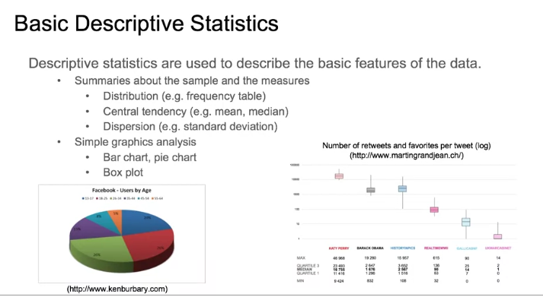

Slide 3
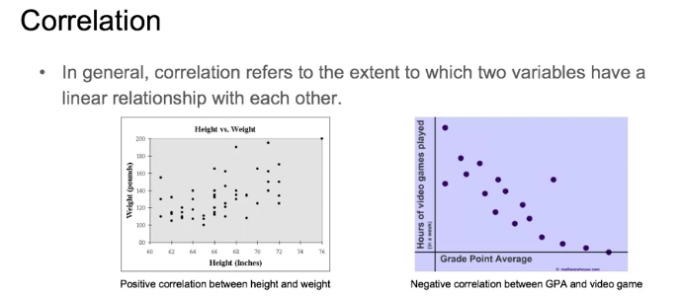

Slide 4
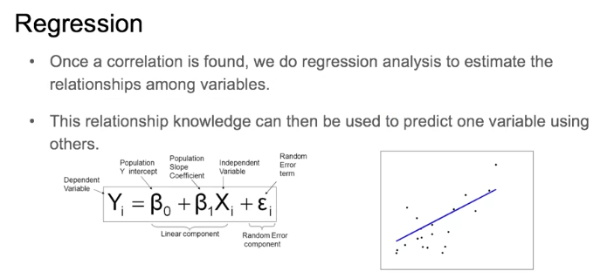

Slide 5
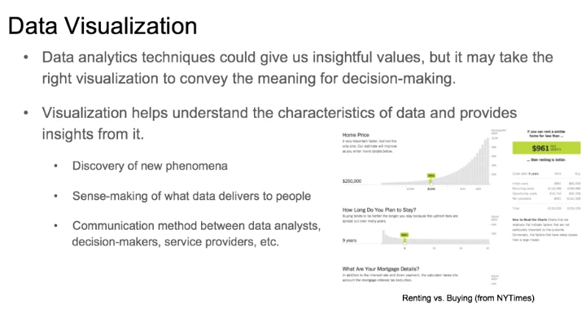

Slide 6

Do you present yourself like this?

Slide 7
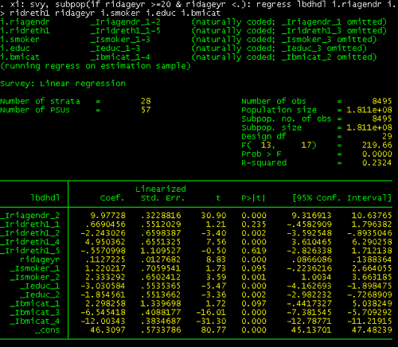
So why would you present your data like this?
Notes:
Speaker notes
Why would you present your data like this? Would most people be able to get the message from this data if it was presented in this STATA output? [ALLOW COMMENTS]
No, it is too busy and it is difficult to interpret.
The way you present your data can greatly affect how usable the data will be.

Slide 8
Or this?
Notes:
Speaker notes
And why would you present your data like this? Can anyone tell me what some problems may be with this chart?
POSSIBLE ANSWERS
No title
No axis labels
The colors are difficult to read. (You should never put a dark color on a dark background.)
The green color is too bright.

Slide 9
This is Better!
Use of ITNs in Zambia
Notes:
Speaker notes
What is improved in this slide compared to the last one? (other than the data points themselves)
POSSIBLE ANSWERS
Title
Axis labels
Data labels
The colors are easy to read.

Slide 10
Effective presentation
Clear
Concise
Actionable
Attractive
Notes:
Speaker notes
Regardless what communication formats you use, the information should be presented in a clear, concise way with key findings and recommendation that are actionable.

Slide 11
Effective presentation
For all communication formats it is important to ensure that there is:
Consistency
Font, Colors, Punctuation, Terminology, Line/ Paragraph Spacing
An appropriate amount of information
Less is more
Appropriate content and format for audience
Scientific community, Journalist, Politicians
Notes:
Speaker notes
An appropriate amount of information will be determined by your audience and format.
Policymakers may do better with direct and concise summaries of key points, whereas the scientific community will want more detail.
On a PowerPoint slide, try to limit to six lines with no more than six words per line, balance text with graphics, and make sure that there are not too many slides.
One way to ensure that you create consistent materials is to decide on a template for the document/presentation/graph, etc., before you produce it. You can then give these guidelines to the different people involved in the process, and then only have to do minor formatting at the end.

Slide 12
Tables: Frequency distribution
Year | Number of cases
2000 | 4 216 531
2001 | 3 262 931
2002 | 3 319 339
2003 | 5 338 008
2004 | 7 545 541
2005 | 9 181 224
2006 | 8 926 058
2007 | 9 610 691
Notes:
Speaker notes
Frequency distribution is a set of classes or categories along with numerical counts that correspond to each one such as number cases in a given year.
What should be added to this table to provide the reader with more information?
POSSIBLE ANSWERS
Better labels-What type of cases? Malaria cases
Title
reference
Source of text on tables and graphs: Pagano M and Gavreau K. Principles of Biostatistics. 1993.

Slide 13
Tables: Relative frequency
Percent contribution of reported malaria cases by year between 2000 and 2007, Kenya
Year | Number of malaria cases (n) | Relative frequency (%)
2000 | 4 216 531 | 8
2001 | 3 262 931 | 6
2002 | 3 319 339 | 7
2003 | 5 338 008 | 10
2004 | 7 545 541 | 15
2005 | 9 181 224 | 18
2006 | 8 926 058 | 17
2007 | 9 610 691 | 19
Total | 51 400 323 | 100.0
Source: WHO, World Malaria Report 2009
Notes:
Speaker notes
In this table, we already had the total number of observations (or n) in the second column but we added a title and the source of the data. Note that this table includes both a title and a reference. The citation is one area where it is acceptable to have typeface that is fairly small in relation to the rest of the text. You do want to have the citation on the slide so that people can know where the data is from if they want that information, but the citation is not the most important part of the slide. You want to draw attention to the data, not the citation itself.
We also added relative frequencies to this table. Relative frequency is the percentage of the total number of observations that appear in that interval. It is computed by dividing the number of values within an interval by the total number of values in the table then multiplying by 100. It is the same as computing a percentage for the interval.
To analyze this table, we should look at the relative frequencies. What do they tell us? There is an increasing trend in the number of reported malaria cases and in the relative frequency of cases.
Does this mean that there is an increase in malaria cases? What would this say about our programs?
It is important to take into account what we already know when interpreting these data. We know that since 2000 there has been an increased effort towards malaria control. During this time period, the quality of treatment has improved and the quality of routine information systems has improved.
When taking this knowledge into account how would we interpret these data?
From 2000-2007, the number of reported malaria cases increased. This may not reflect an actual increase in cases, but an increase in care seeking and reporting. Due to improved case outcomes seen after the introduction of ACTs in Kenya in 2004, individuals with fever began to seek care at formal medical facilities at higher rates. Furthermore, the routine information system improved during this period of time and thus reported more complete information.
Source of text on tables and graphs: Pagano M and Gavreau K. Principles of Biostatistics. 1993.

Slide 14
Use the right type of graphic
Charts and graphs
Bar chart: comparisons, categories of data
Histogram: represents relative frequency of continuous data
Line graph: display trends over time, continuous data (ex. cases per month)
Pie chart: show percentages or proportional share
Notes:
Speaker notes
We’re going to review the most commonly used charts and graphs in Excel/PowerPoint. Later we’ll have you use data to create your own graphics which may go beyond those presented here.
Bar charts are used to compare data across categories.
A histogram looks similar to a bar chart but is a statistical graph that represents the frequency of values of a quantity by vertical rectangles of varying heights and widths. The width of the rectangles is in proportion to the class interval under consideration, and their areas represent the relative frequency of the phenomenon in question A histogram is a histogram, not just because the bars touch. In the bar graph bars in a bar graph can touch if you want them to ... but they don't have to. Touching bars in a bar graph doesn't mean anything. In a histogram, however, the bars must touch. This is because the data elements we are recording are numbers that are grouped, and form a continuous range from left to right. There are no gaps in the numbers along the bottom axis. This is what makes a histogram.
Line graphs display trends over time, continuous data (ex. cases per month)
Pie charts show percentages or the contribution of each value to a total. When there are more than 4 categories it is best to go to a bar chart so that it is readible

Slide 15
Bar chart
Notes:
Speaker notes
In this bar chart we’re comparing the categories of data which are any net or ITN.
What should be added to this chart to provide the reader with more information?
Add a title and data labels. You could also add the source of the data but it isn’t necessary if all of your tables and graphs are derived from the same source/dataset.
On the next slide we see how the graph has been improved and is now self-explanatory.

Slide 16
Bar Chart
Source: Quarterly Country Summaries, 2008
Notes:
Speaker notes
Note that this chart has a title, axis labels , data labels, and a source. It is best if you limit the bars to 4-8 to keep it readable, especially if it is to be used in a PowerPoint presentation.

Slide 17
Stacked bar chart
% Children <5 with Fever who Took Specific Antimalarial, 2007-2008
Notes:
Speaker notes
A stacked bar chart is often used to compare multiple values when the values on the chart represent durations or portions of an incomplete whole, such as the percentage of children taking each type of medication for fever when not all children received medication at all.

Slide 18
Histogram
Notes:
Speaker notes
This is a histogram. At first glance, histograms look a lot like bar charts. Both are made up of columns and plotted on a graph.
However, there are some key differences. The major difference is in the type of data presented on the x (horizontal) axis. With bar charts, each column represents a group defined by a categorical variable. This variable could be types of sports, different football teams, health facilities, or provinces. These are all categories.
A histogram presents quantitative variables; the groups on the chart are always made up of numbers or something that could be turned into numbers. This could be age, height, weight, the number of minutes women wait in a queue, years, or months of the year. These groupings are sometimes called “bins.” The bin label can be a single value or a range of values. For example, you could split out the time spent waiting in line by the minute (5 minutes, 6 minutes, 7 minutes) or you could split it into chunks (less than 5 minutes, 6-10 minutes, 11-15 minutes).

Slide 19
Line graph
Number of Clinicians* Working in Each Clinic During Years 1-4, Country Y
*Includes doctors and nurses.
Notes:
Speaker notes
A line graph should be used to display trends over time and is particularly useful when there are many datapoints. In this case we have 4 datapoints for each clinic.
By adding a label to the y-axis, a title and a footnote. In some settings, clinicians may only mean doctors but to be clear the footnote let’s the reader know that in this case we are referring to both doctors and nurses.

Slide 20
Caution: Line Graph
Number of Clinicians* Working in Each Clinic During Years 1-4, Country Y
*Includes doctors and nurses.
Notes:
Speaker notes
What is wrong with this line graph? If you look closely you can see that the X axis should be years, but instead it is clinics. Make sure that the right data is always charted on the axes, or else you may end up with a graph that cannot be interpreted like this one.

Slide 21
Pie chart
Notes:
Speaker notes
A pie chart displays the contribution of each value to a total. In this chart, the values always add up to 100.
What should be added to this chart to provide the reader with more information?
What should be changed about this chart to make it more readible?
POSSIBLE ANSWERS
The color scheme, which is currently too bright
The title should be more specific and indicate whether these are numbers or percentages.
If these are percentages, that should be listed on the data and the n, or number of cases should be indicated to provide context.

Slide 22
Pie chart
Percentage of all confirmed malaria cases treated by quarter, Country X, 2011
N=257
Notes:
Speaker notes
A pie chart displays the contribution of each value to a total. In this case we used the chart to show contribution of each quarter to the entire year. For example, the first quarter contributed the largest the percentage of enrolled patients.
To improve the understanding of the pie chart, we’ve added a more descriptive title and added value labels. On the previous chart, we couldn’t tell if the values are numbers or percentages. Adding the sample size let’s us know the total number of observations. For example
It is also important to have charts that are attractive, easy to look at and easy to read. The chart on the previous page was so colorful that it was distracting, the colors were so bright that it was hard to look at the chart, let alone read it. While these colors are not the most interesting, they let the reader focus on the chart. The last chart was an exaggeration, but be sure to make sure that you do not make the same mistake on a smaller level.
Limit the slices to 4-6. For extra pizzazz, contrast the most important slice either with color or by exploding the slice.

Slide 23
Pie Chart
Source: MEASURE Evaluation, Retention, Use and Achievement of “Universal Access” Following the Distribution of Long Lasting Insecticide Treated Nets in Kano State, Nigeria, 2009
Notes:
Speaker notes
Please open the file called graphs from the data presentation folder on your cd. We are going to use the data there to create this and the other charts and graphs in this session. For all of these charts, I want you to try to duplicate the chart shown in the PPT slide exactly. This is not to say that this chart is perfect; however, trying to copy this exactly will allow you to explore some of the chart making functionality in Excel.
Go over making this chart with the participants. Show them how to do it using the standard chart layouts in Excel (this is layout 6 in Excel 2007) and also how to adjust aspects such as the legend, data labels and colors of the chart using the layout tab.

Slide 24
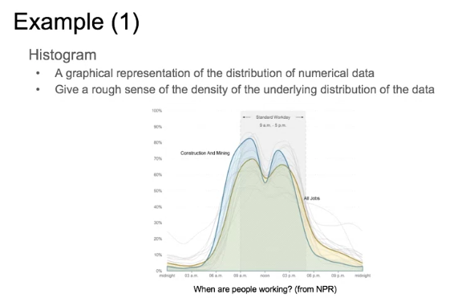

Slide 25
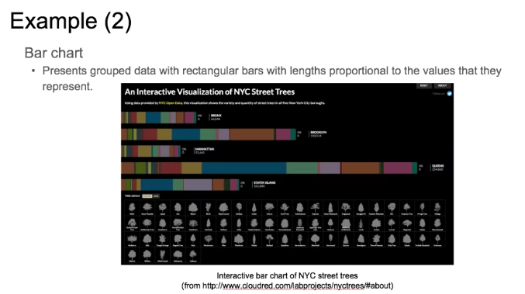

Slide 26
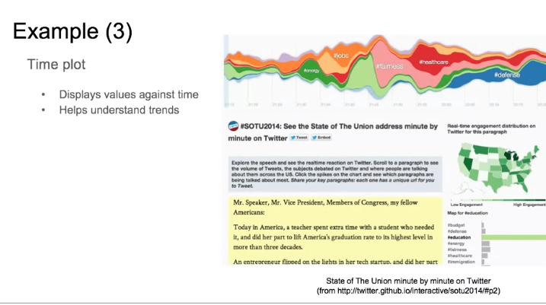

Slide 27
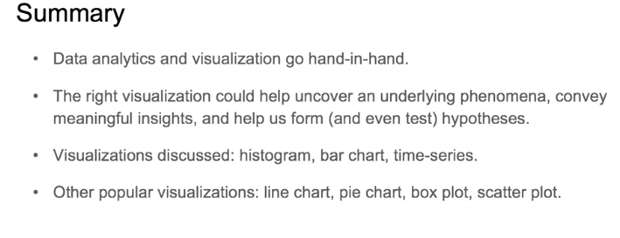

Slide 28
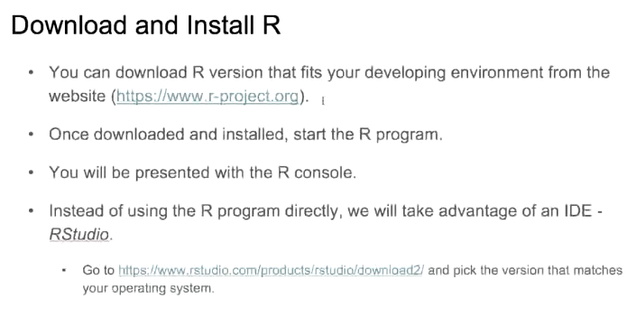

Slide 29
